Slide 1
Lessons Learned & the Better Buildings Residential Program Solution Center
Amanda Chiu, CSRA
March 24, 2016

Slide 2
Outline
Background
Lessons Learned from BBNP Evaluation
Tour of the Residential Program Solution Center
Use Examples

Slide 3
POLL: What area of the program do you work in?
Contractor engagement
Workforce development
Marketing & outreach
Financing
Other

Slide 4
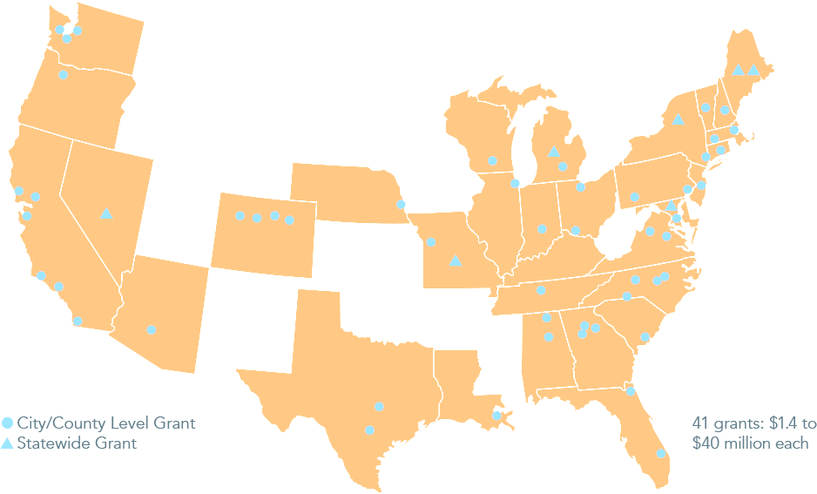
Better Buildings Neighborhood Program
$508 million in grants:
$1.4 to $40 million each
Created >10,000 jobs by supporting small businesses
Completed 119,000 home energy upgrades
Saved consumers $850 million (estimated lifetime energy savings)
Trained >5,600 home performance workers to enhance their skills
Spurred $1.3 billion in economic activity
Notes:
DOE administered the Better Buildings Neighborhood Program to support programs promoting whole building energy upgrades.
BBNP distributed a total of $508 million to support efforts in hundreds of communities served by 41 grantees. DOE awarded funding of $1.4 million to $40 million per grantee.
Leading communities used innovation and investment in energy efficiency to expand the home performance industry & test program delivery business models.
Evaluation report released June 2015:
Bottom line (goal/objective attainment)
Energy and CO₂ impacts
Program implementation lessons learned
Market effects findings

Slide 5
BBNP Evaluation Report: 12 Best Practices
Offer multiple types of energy assessments
Directly install measures during the energy assessment
Provide a flexible approach to conduct comprehensive upgrades
Keep the program simple for your customers
Provide multiple types of training to contractors
Develop large pools of eligible contractors
Foster relationships with contractors
Conduct effective QA/QC
Notes:
6 volumes – give me your card.
I want to plant a seed for you to think about during this session. Towards the end, I will ask you to share a key lesson learned from your experience. Hopefully what you hear will resonate with your experiences, and perhaps you’ll have a different perspective or nuance to effective program design.
Here we show 12 best practices derived from the most effective approaches identified in the evaluation report.
Bold – These program elements and characteristics are particularly likely to contribute to success.
Not bold – These program elements and characteristics are associated with success.
Evaluation findings are currently being added to the Solution Center.
The process evaluation drew on interview and survey information collected from the grantees, DOE program staff and contractors, program participants and nonparticipants, contractors serving participants, and financial institutions working with the grantees. In addition, an extensive review of pertinent literature informs the evaluation. The process evaluation identify the most effective approaches – including program design and implementation activities – to completing building energy upgrades that support the development of a robust retrofit industry in the U.S.

Slide 6
BBNP Evaluation Report: 12 Best Practices (cont.)
Have at least one staff member with 15+ years of relevant experience
Tailor outreach activities to target populations, but don’t restrict participation
Offer financing as a component of the program
Offer incentives at ~25% of project costs

Slide 7
View the evaluation reports on the Better Buildings Neighborhood Program:
http://energy.gov/eere/better-buildings-neighborhood-program/accomplishments#reports

Slide 8
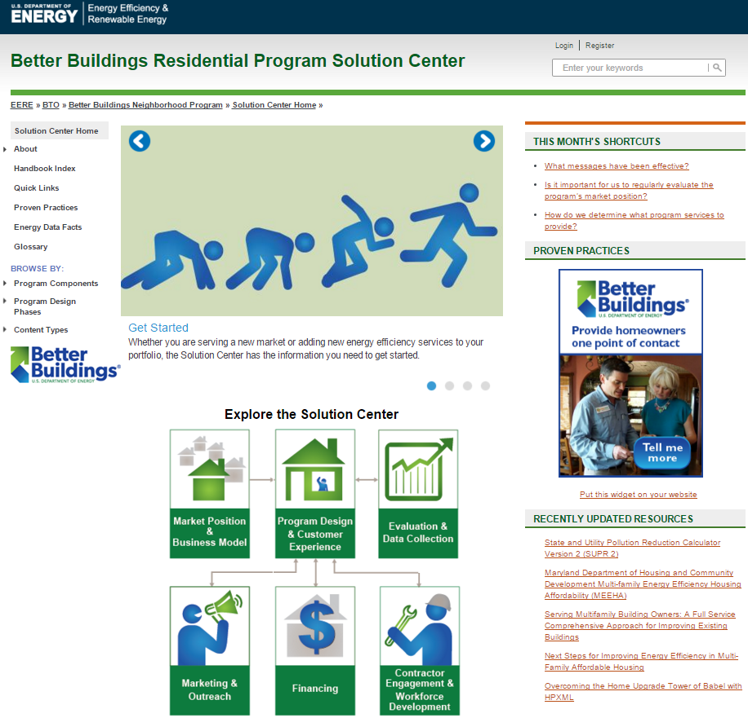
Welcome to the Residential Program Solution Center!
Notes:
So where can you find more and more detailed information about best practices and lessons learned?
The purpose behind the Solution Center is to help programs in the future not have to start from scratch when they are thinking about:
what strategies they might employ
what kind of program design they are going to go after
and how they would engage the marketplace of consumers.
We want to help minimize trial and error & help programs and their partners plan, operate, and evaluate their programs.
The SC a living repository of examples, lessons, and resources. We are actively engaging with programs, who may or may not have DOE partners in the past, in search of additional examples and lessons learned from their perspective that we can add. And we will continue to do that in the future.
Information is organized around Program Components

Slide 9
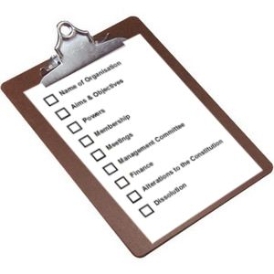
Purpose: No More Starting from Scratch
Help residential energy efficiency programs minimize trial and error to achieve success.
Help programs and partners plan, operate, and evaluate their programs.
Provide a living repository of examples, lessons, and resources.
Notes:
The purpose behind the Solution Center is to help programs in the future not have to start from scratch when they are thinking about:
what strategies they might employ
what kind of program design they are going to go after
and how they would engage the marketplace of consumers.
We want to help minimize trial and error, help programs and their partners plan, operate, and evaluate their programs.
Our intent is to provide a living repository of examples, lessons, and resources. We are actively engaging with programs, who may or may not have DOE partners in the past, in search of additional examples and lessons learned from their perspective that we can add. And we will continue to do that in the future.

Slide 10
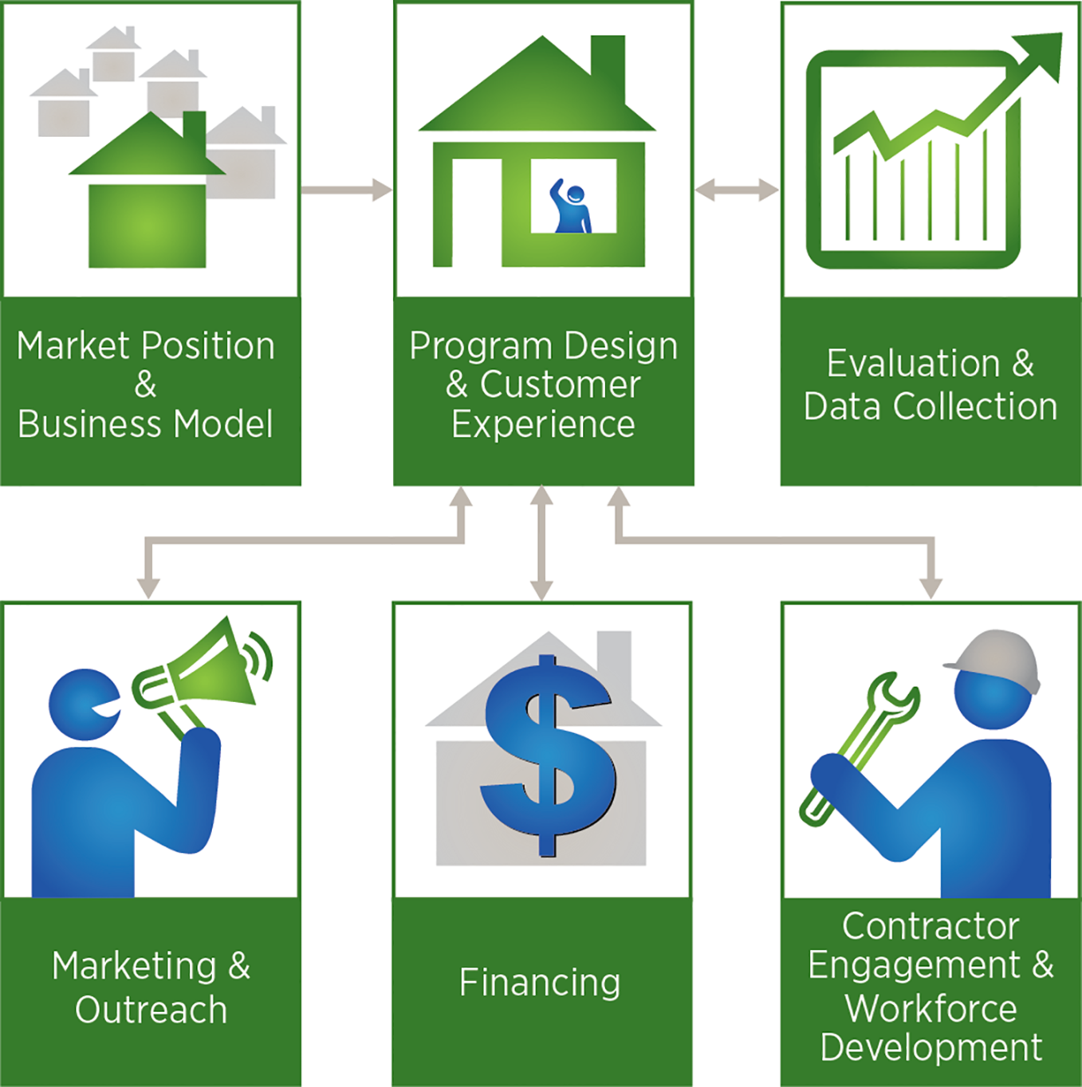
Solution Center Framework
Notes:
Let’s get started with the framework. The content in the Solution Center is built around six main program components, or aspects of a program that relate to planning, operations, and implementation.
Those six components start in the upper left corner with market position and business model:
This component specifically asks what kind of organization are you and therefore what kind of constraints are on your ability to implement the program, what kind of considerations do you have to keep in mind, and also what kind of partnerships might be most relevant to you.
A utility program that is operating in a regulatory environment where there are energy efficiency targets or where there are strict cost effectiveness tests will probably look relatively different from a state-energy-office-run program or an NGO-run program that isn’t facing those same type of constraints, but might instead be facing funding constraints in a different way.
The market position and business model is the place to start to flag what kind of an organization you are and how you might need to operate as a result.
That leads into our central component around program design and customer experience:
Customer experience is central because we found through experience that programs are very complicated when it comes down to it on the ground and behind the scenes. Ultimately, if the customer isn’t kept central the program is not going to work. It’s not going to achieve its goals. The program has to provide a positive customer experience. Otherwise the customers are not going to come back. They’re not going to refer their friends. You lose a lot of opportunities as far as word of mouth, and free marketing and outreach. And you’re probably not going to get the energy savings you were expecting.
Our program design piece is bolstered by the three components on the bottom. These are the components that people most frequently think of when they are thinking about how to run a residential energy efficiency program:
First is marketing and outreach: how do you get customers engaged in the first place?
Second is financing: how are they going to pay for the upgrade measures that you want them to install? Whether you offer the financing or a partner does.
Third is the most important partnership - with your contractors and ensuring that you have got an engaged contractor base who is working in true partnership with the program and vice-versa. And if you don’t have fully qualified contractors sufficient to meet your program’s need, then you would need to engage in workforce development, as well.
Then if you go back up, last but not least, in the upper right corner you see the evaluation and data collection box:
This is how we answer the question of how well have we been doing.
You need to assess that on a regular basis, but also most programs have to assess periodically on what they have accomplished: how it looks as far as their return on investments. And some of that relates to cost effectiveness, typically.
These are the six major operational areas of a program, and so all of the content in the Solution Center is housed within one of each of these six areas.

Slide 11
Handbooks – Description
Description: Why the stage is important and what user will learn
Notes:
Handbooks are the primary pieces of content in the Solution Center
A handbook is a reference manual that explains why and how to implement specific stages of a residential energy efficiency program
Each handbook contains a series of tabs shown here that allows users to quickly identify the type of information and resources they are looking for.
The structure starts with a description:
The description tab will say why that particular stage is important and what the user will learn.
It also will give you some tips about other key resources that might be relevant elsewhere in the Solution Center or other DOE resources that are available on the Web

Slide 12
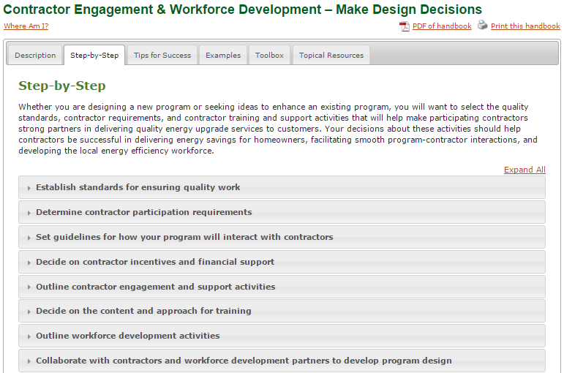
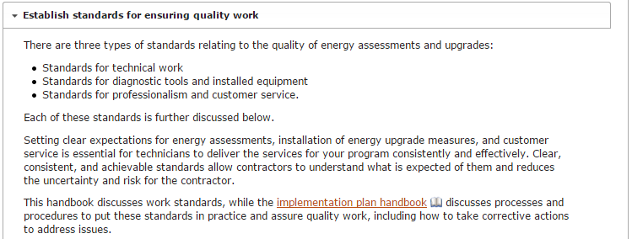
Handbooks – Step-by-Step
Step-by-Step: Detailed what and how information
12
Notes:
The step-by-step tab tells you what the stage really means and how you can do it – how you can implement it.
***Selecting a step allows opens an accordion to access information.

Slide 13
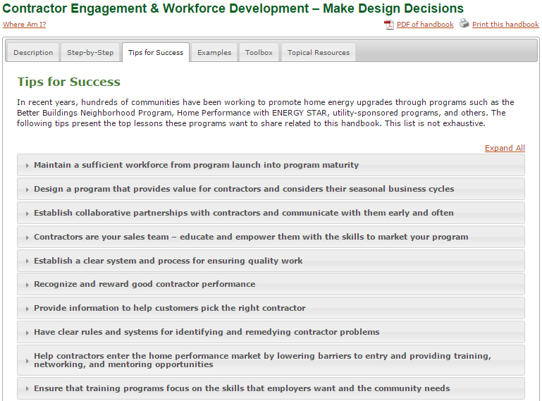
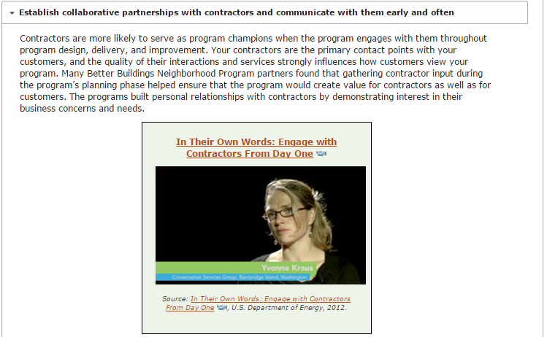
Handbooks – Tips for Success
Tips: Lessons based on documented experience from multiple programs
13
13
Notes:
The third tab in each handbook is called “tips for success.”
Tips for success are lessons that are based on documented experience from multiple programs.
All the tips for success are what multiple programs have said they learned the hard way, they want users of the Solution Center to not have to start from scratch and benefit from their own experience.
Within a tip for success, it will:
Describe what the particular barrier is that is being overcome with this strategy or approach.
Give you a synopsis of why that has been valuable and then it will provide multiple examples for particular programs that have actually gone through and demonstrated that this was valuable to them.
Give you information about what their market looks like and what kind of results they achieved.

Slide 14
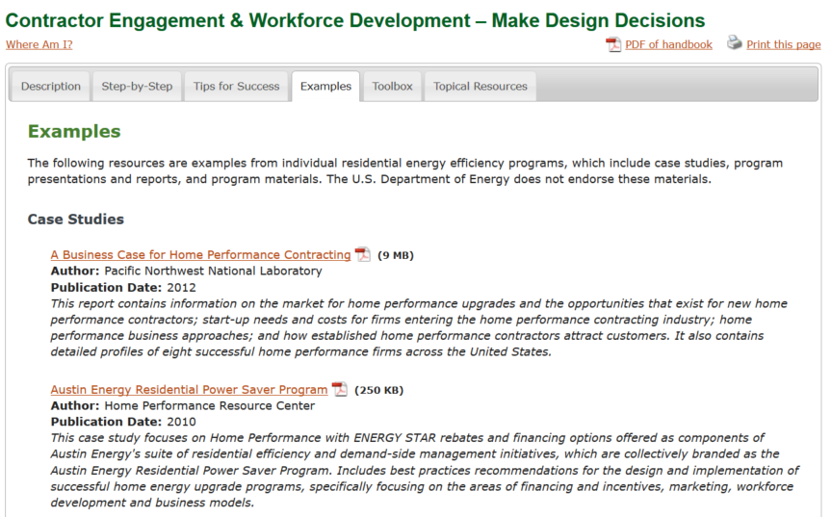
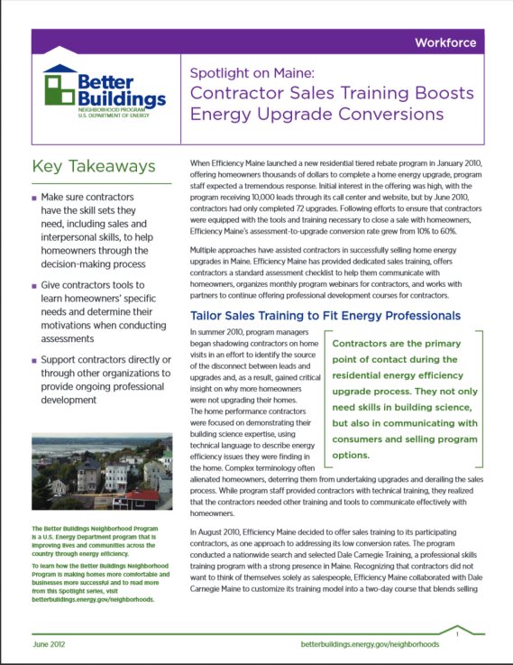
Handbooks – Examples, Toolbox, and Topical Resources
Case studies, program presentations and reports, materials from energy efficiency programs
14
14
Notes:
The last tabs in each handbook are the “examples,” “toolbox,” and “Topical resources” tabs. These include:
Case studies
Presentations and reports from programs themselves
Materials from individual energy upgrade programs.
These are all different kinds of examples of resources that programs themselves have developed talking about their own initiatives, their strategies, their results, etc. in their own words.
You can click on any of these to download the PDF, download the PowerPoint, etc.
***Here you see a Case Study of how Efficiency Maine used contractor sales training to! boost the energy upgrade conversion rate from 10% to 60%

Slide 15
Highlights of the Solution Center
Notes:
On the left navigation bar you have options to browse by program components or design phases or browse by content types which allows you to access all resources in the Solution Center (handbooks, case studies, tools, calculators, publications, etc.)…filters available to help you focus in on what you are looking for.
***You also have an open text search at the top right. Entering any term will return a list of Solution Center resources to access…again, there are filters available to help you find what you are looking for.
***You have the widget that highlights new proven practices in the Residential Program Solution Center each month.
***Finally, we have a new feature on the right side of the page called Shortcuts which pose a question and then will take you to the most applicable handbook (these will be rotated monthly).

Slide 16
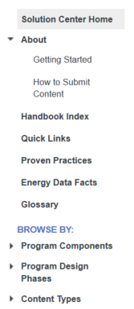
Highlights of the Solution Center

Slide 17
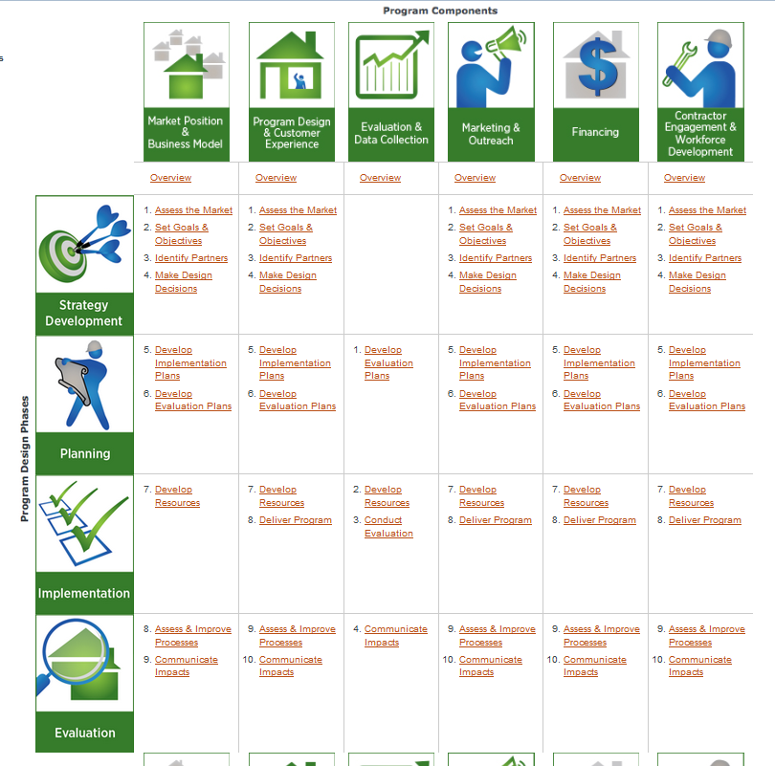
Handbook Index – 50+Handbooks
Explore by program component or program design phase
Notes:
As I mentioned, you can access handbooks in a given component in the center of the homepage, but a very useful option available in the left hand nav is the Handbook Index.
Looking at the list of handbooks in this index form allows you to see the similar structure of handbooks across components. Each component has an Overview handbook, which essentially serves as an executive summary for the component (what it is, why it’s important, etc.) and handbooks for up to 10 stages a program might want to follow to successfully address a given component.
The Handbook Index quickly allows you to see handbooks across components and access a specific handbook quickly.

Slide 18
Highlights of the Solution Center

Slide 19
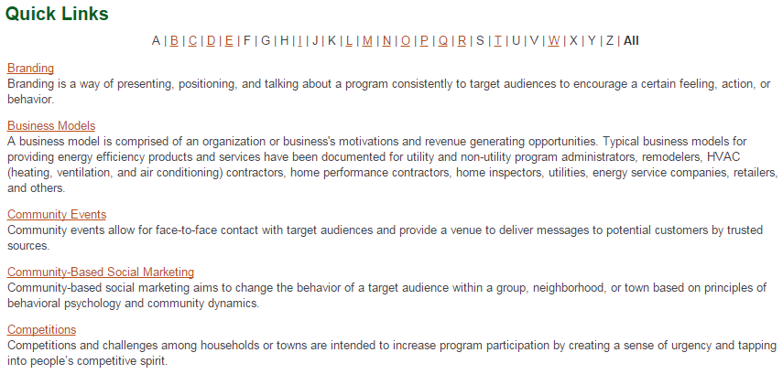
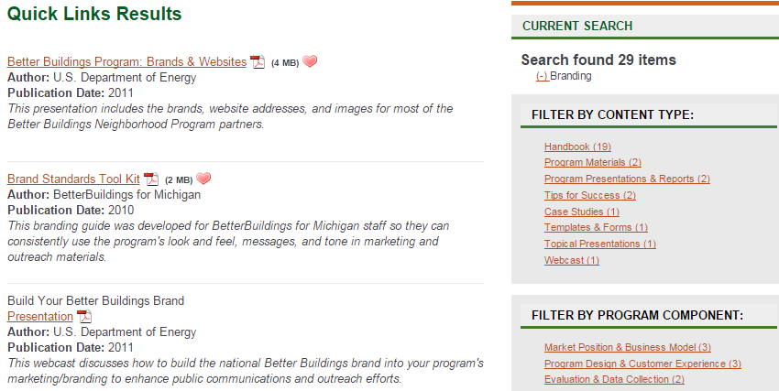
Quick Links
Select a Quick Link to see curated resources, including case studies, presentations, tools, calculators, templates, and more.
Notes:
We’ve identified topics at the forefront of many program administrators’ minds and put together a curated list of resources to shed some light on those topics.
You can click on a Quick Link and be presented with case studies, reports, toolkits, templates, and other resources that can help you think through an issue.

Slide 20
Highlights of the Solution Center

Slide 21
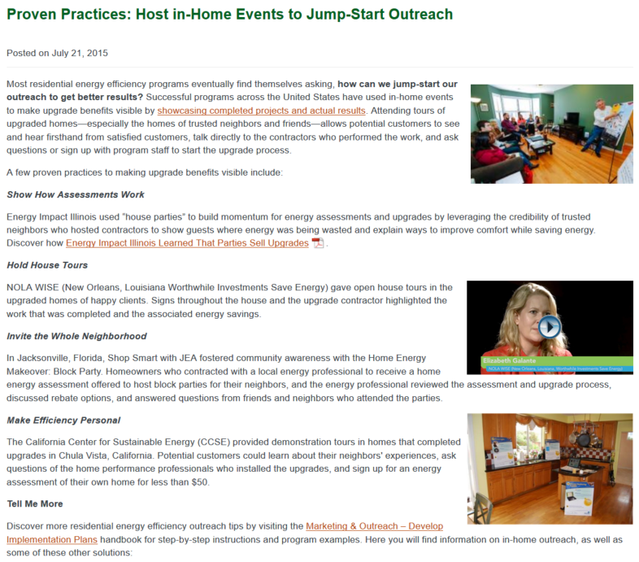
Proven Practices
Monthly posts about lessons learned, program examples, videos, and helpful tips to take your program to the next level.
Notes:
Proven Practices posts put a spotlight on one lesson learned or best practice identified by many programs each month, and includes examples of what some have done to implement the strategy.
The widget is an online application that displays new proven practices each month. Add to your website with a small piece of code. No technical maintenance–content is updated automatically.

Slide 22
Use Examples
Notes:
So, let’s walk through some specific examples of some questions that we are asked relatively frequently and that you can answer on your own now with the Solution Center.

Slide 23
POLL: Indicate the question you are most interested in hearing about today.
How do I identify and recruit contractors?
How do I learn about the capabilities and services of existing contractors in my market?
How do I develop a quality assurance plan for my program?
Notes:
Here are 3 questions you might want to find answers to in the Solution Center.
To find these answers you have a number of starting points. Most notably…
Homepage component icons
Handbook Index
Search
As I go through these examples you’ll see how these options work.

Slide 24
Example #1: Homepage (1 of 8)
How do I identify and recruit contractors?
Notes:
“How do I identify and recruit contractors?”
Since we are looking for information about contractors we can click on the Contractor Engagement & Workforce Development icon to access related handbooks.

Slide 25
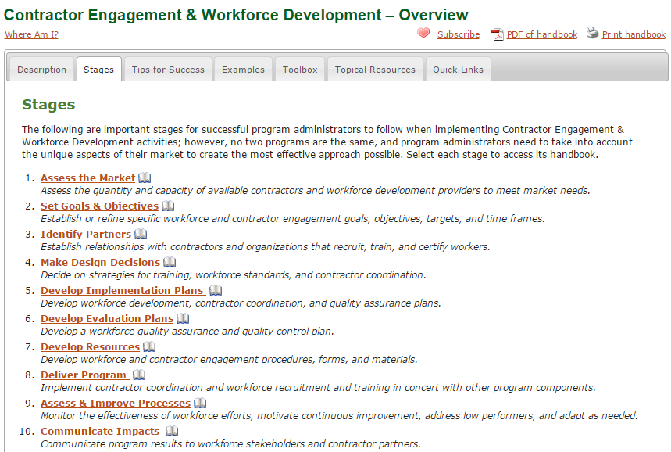
Example #1: - Overview Handbook (2 of 8)
Notes:
Here is the Contractor Engagement & Workforce Development-Overview handbook. Once again, the description tab provides a high level overview of this program component. The Stages tab, shown here, provides descriptions and links to all the related handbooks.
When we review the descriptions we see that the Identify Partners handbook will answer our questions about partnering with contractors.

Slide 26
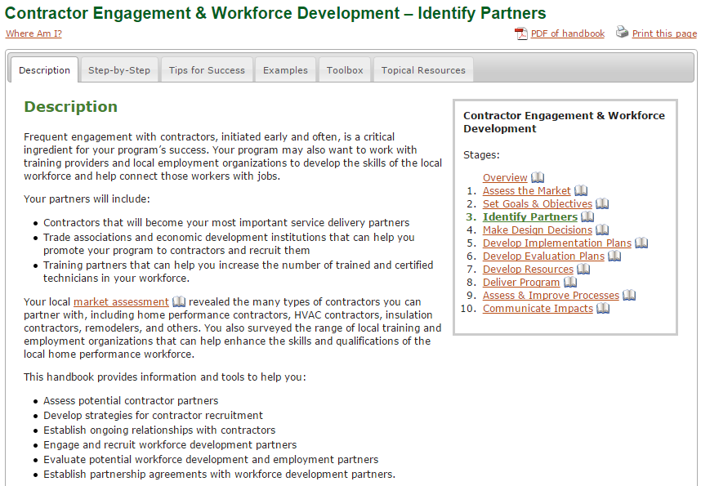
Example #1: Handbook (3 of 8)
Notes:
The Contractor Engagement & Workforce Development – Identify Partners handbook discusses ideas of establishing relationships with contractors around recruitment, training, and certifying workers.

Slide 27
Example #1: Find Related Info (4 of 8)
Notes:
As we just saw the Contractor Engagement & Workforce Development-Identify Partners description tab includes an overview of the handbook. At the bottom of the Description, we have links to other related handbooks across program components, including:
Market Position & Business Model-Understanding the value of partners and how to identify and engage them in your business model design
Program Design & Customer Experience – overview of how to establish relationships with organizations that can help you deliver your program
Marketing & Outreach – Specifics on how to establish relationships with orgs that can assist with marketing and outreach
Financing – Specifics on how to identify and partner with financial institutions.
This allows you to easily make the connections between program components.

Slide 28
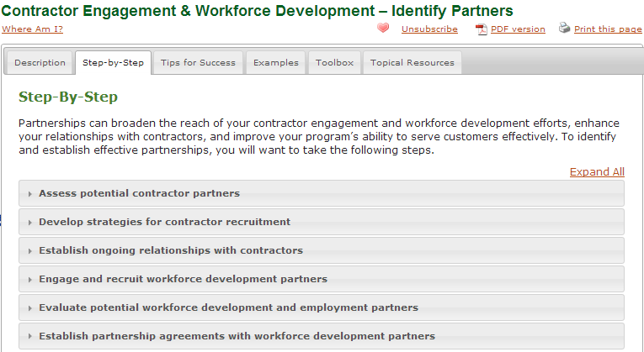
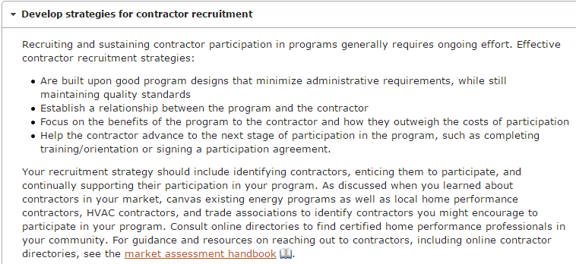
Example #1: Step-by-Step (5 of 8)
Notes:
On the next tab, you can find detailed guidance on steps to assess, develop strategies, engage and recruit the workforce.
***We might pick one around developing strategies for contractor recruitment in particular.
This provides a few suggestions of particular approaches that you might want to use to do contractor recruitment, and also provides links for other handbooks and places where we talk about contractor recruitment. It also gives you examples, tips, and guidance.

Slide 29
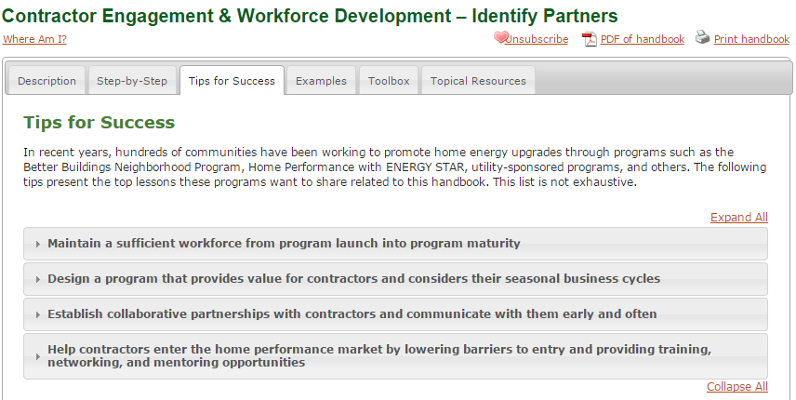
Example #1: Tips for Success (6 of 8)
Notes:
You might also be interested in tips for success: what have other programs learned when they’ve gone through and tried to engage contractors and recruit them to their program?
***One of those tips is around helping contractors enter the market by lowering barriers to entry and providing them with training, networking, and mentoring opportunities.
In this tip, you can read about a variety of ways you can help contractors overcome the barriers to entry in the marketplace. The common barriers we’ve heard about included long delays to receive payment for the program, paperwork burdens that can sometimes enough to make contractors reluctant to participate, program expectations that were unclear to contractors, and upfront costs (e.g. for equipment purchases). How have some programs responded to these issues? You can also read about those strategies through program examples.
The photo you see here takes you to a video from BetterBuildings of Michigan describing in their own words how contractor mentoring benefits both programs and contractors.
You can read about Rutland County in VT and how they helped develop their contractors weather their seasonal workload and peaks in demand as a result of the program.
Another example is Enhabit in Oregon. They provided networking and mentoring opportunities that connected new technicians with the more experienced. They also held morning meetings twice a month to connect contractors to each other. Through some close coordination, the program helped local contractors network and eventually develop the Home Performance Guild of Oregon.

Slide 30
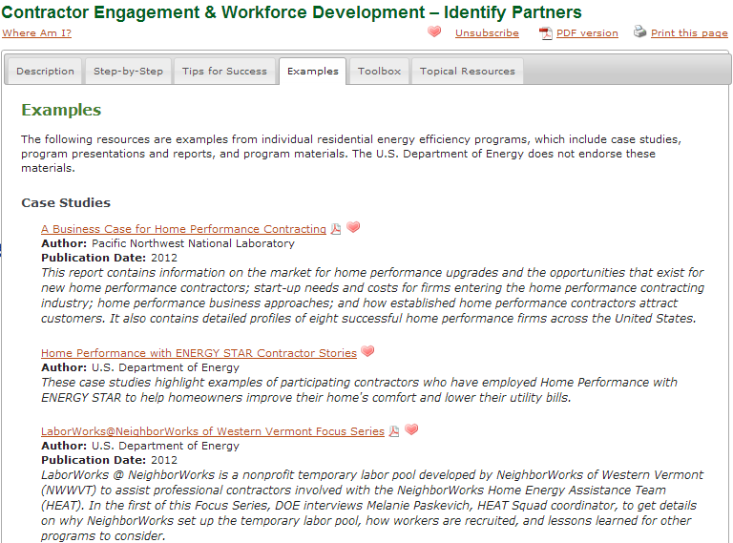
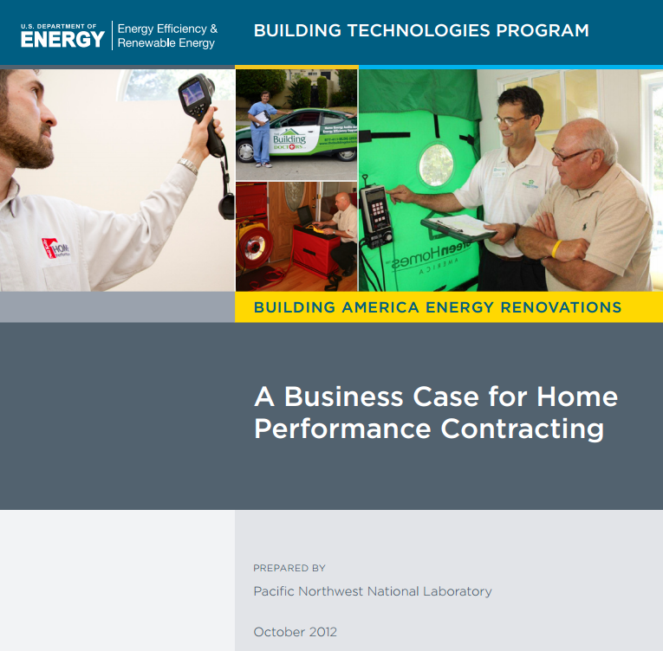
Example #1: Examples (7 of 8)
Notes:
As we move through the tabs of this handbook, and you’ll find that in terms of case studies, ***we actually have an entire business case for home performance contracting (located here on the Examples tab).
This would be valuable for you to understand if you’re interested in recruiting contractors because you need to understand how they operate, how they think, and what kinds of enticements might be motivating to them to get them to engage with your program.

Slide 31
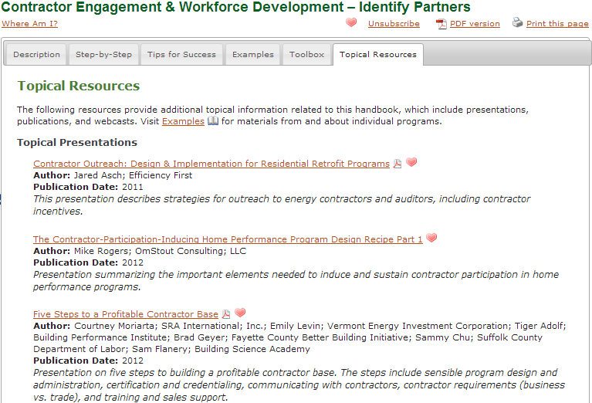
Example #1: Topical Resources (8 of 8)
Notes:
The last tab on topical resources includes a variety of presentations related to recruitment.
***This particular one we’ve got here is about 5 steps to a profitable contractor base. Participating in a program can benefit contractors by generating good leads, but that participation does have a cost associated with it in terms of time and resources. So how do you design a program that meets your goals without causing undue burden to your contractors (minimize the hurt) and facilitating their profitability (making participation attractive)?
You can go through the PowerPoint and get more detail.

Slide 32
Example #2: Handbook Index (1 of 3)
How do I learn about the capabilities and services of contractors in my market?

Slide 33
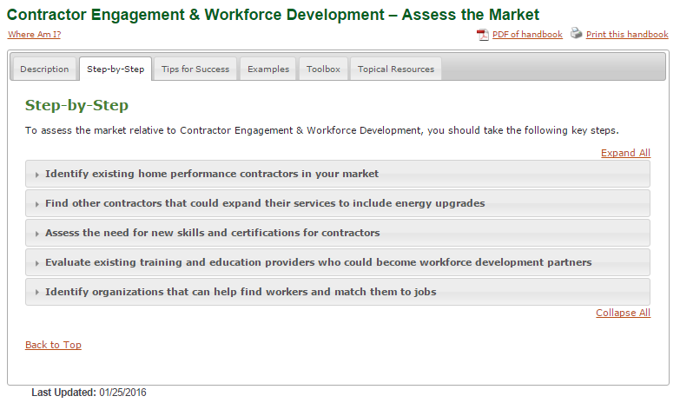
Example #2: Assess the Market Handbook (2 of 3)
Step-by-Step: Provides detailed what and how information related to the topic.

Slide 34
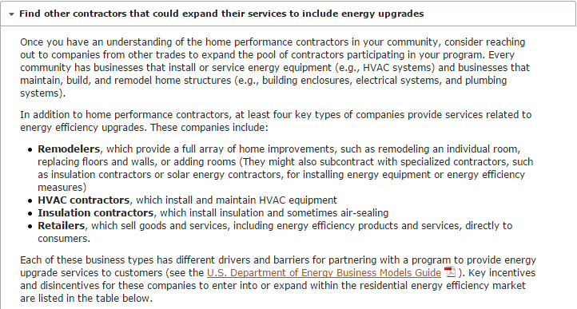
Example #2: Step-by-Step (3 of 3)

Slide 35
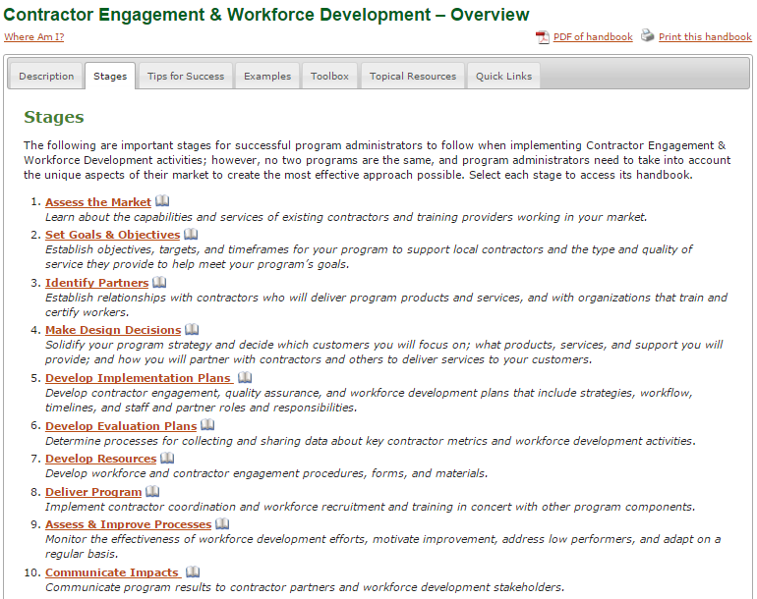
Example #3: Overview Handbook (1 of 5)
How do I develop a quality assurance plan for my program?
Tip: Overview handbook “Stages” tab describes all of the handbooks in that program component.

Slide 36
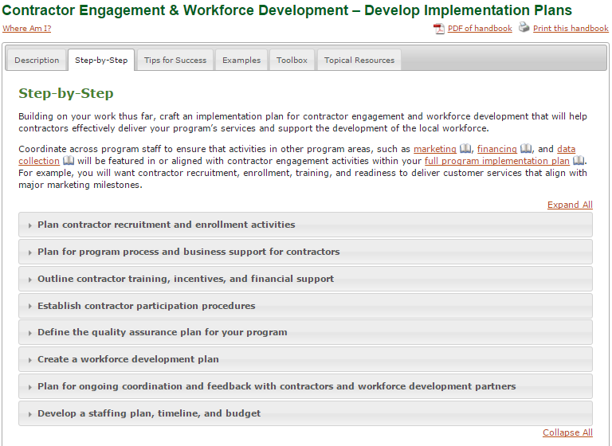
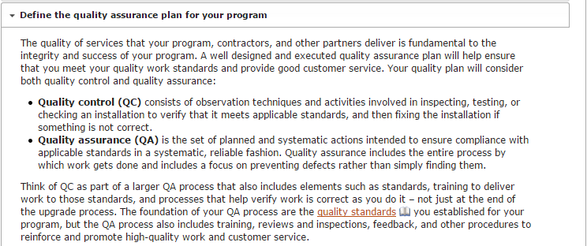
Example #3: Step-by-Step (2 of 5)
Notes:
This step goes into detail about the key stages of a QA process like the paper review and field inspections and how to provide feedback to contractors; resources available for you like the Weatherization Assistance Program’s Quality Work Plan; and examples of what other programs have done.

Slide 37
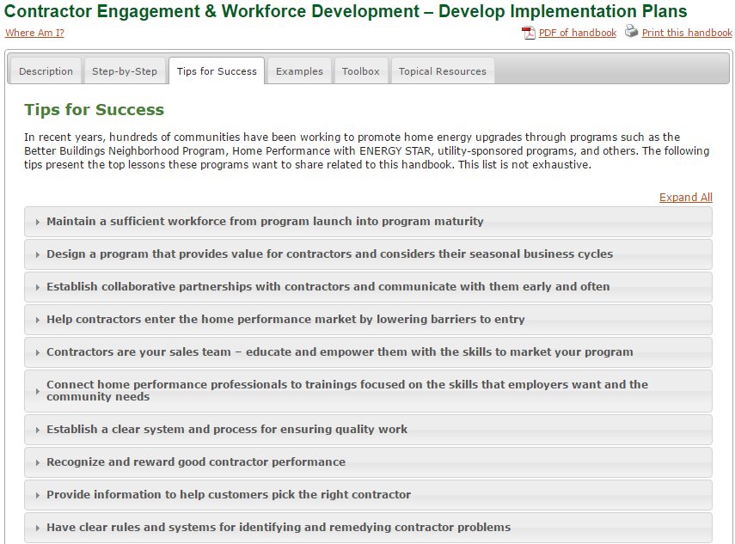
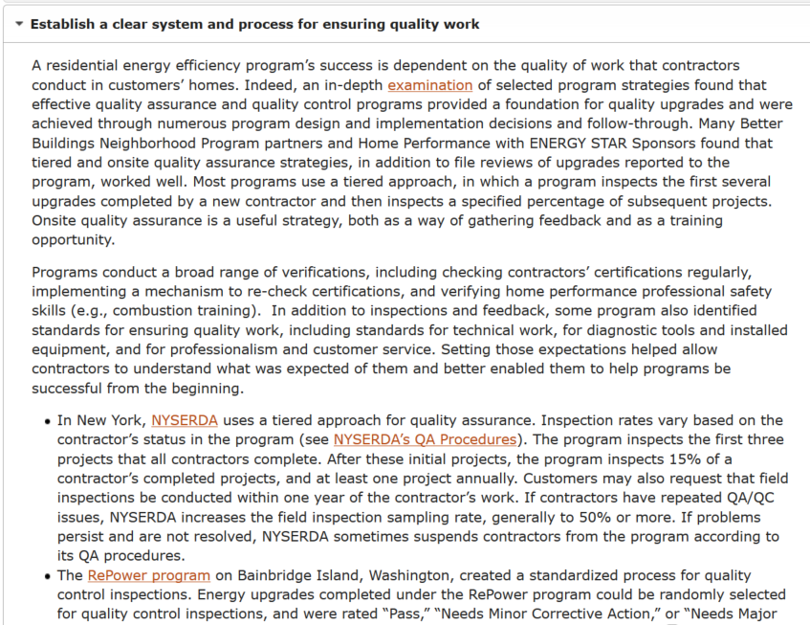
Example #3: Tips for Success (3 of 5)

Slide 38
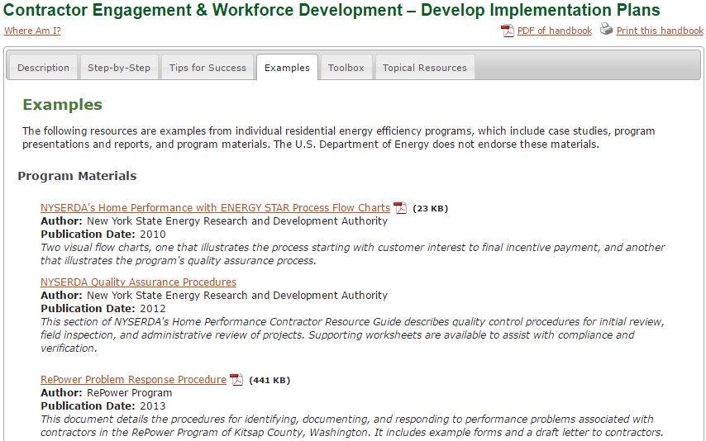
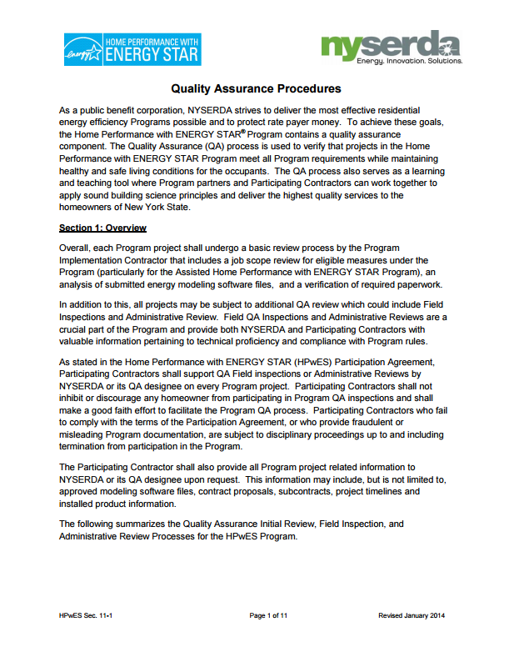
Example #3: Examples (4 of 5)

Slide 39
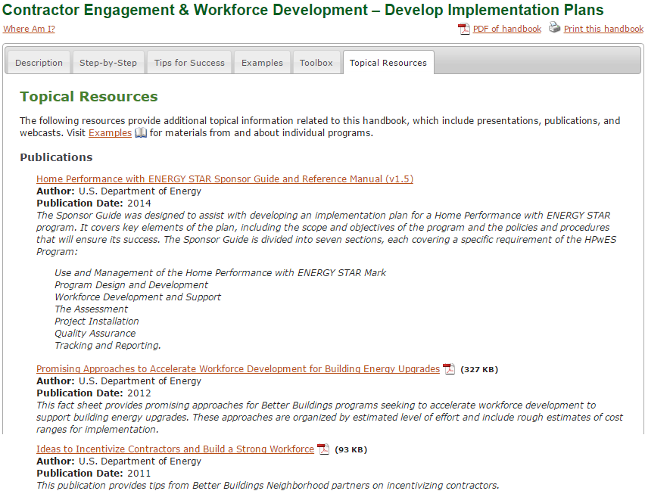
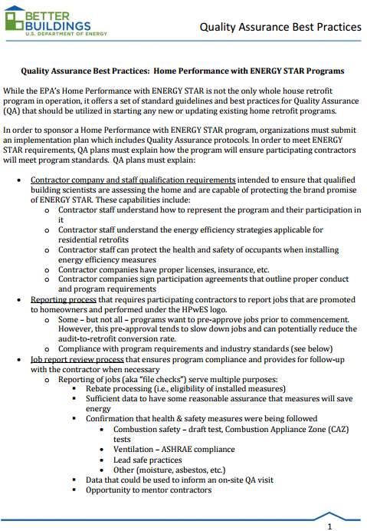
Example #3: Topical Resources (5 of 5)

Slide 40
Access the Solution Center: energy.gov/rpsc
Suggestions? BBRPSolutionCenter@ee.doe.gov
Notes:
Point out handouts

Slide 41
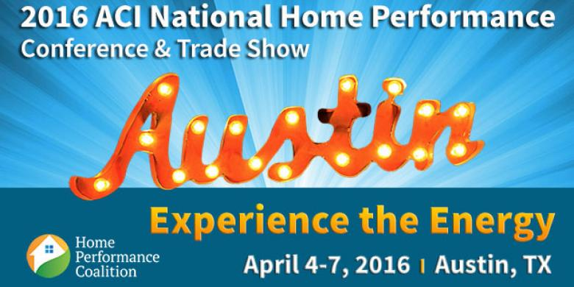
Join us @ ACI National Home Performance 2016
Kick-off with DOE on Monday, April 4!
Home Performance with ENERGY STAR Partner Meeting, 8:30 – 5:00 PM
including special afternoon breakout sessions:
Home Energy Score partner meeting
Home Energy Information Accelerator partner meeting
Home Improvement Catalyst - Leveraging the home improvement marketplace for energy upgrades
Getting Started with HPXML workshop – Monday afternoon
Meet us at many more sessions, April 5-7!

Slide 42
Meet us at sessions, April 5-7!
Tuesday, April 5
Home Upgrade Program Models for Acquiring Savings in Multiple Climate Zones
Residential Energy Labels, Why Should You Care & What Do You Do About It?
Wednesday, April 6
Showcasing Home Performance with ENERGY STAR Contractors
Transforming the Market with HPXML: Strategies and Lessons Learned
What Building America Learned in 4 Years About Retrofits & Staged Upgrades
Realizing the Market Value for High Performance Homes: Reports from the Field
Health & Home Performance: Unlocking New Funding, Marketing, & Project Data Value
The Quest for Smarter Performance Measurement
The Home Energy Data Huddle: Getting together to Build an Information Pipeline
The Value Proposition Challenge
Thursday, April 7
Home Performance Financing Update & Options to Help Close More Jobs
Your Contractors: A Gateway to Better Programs
America’s Building Blocks to High Performance Housing
Download full ACI National Home Performance Conference Agenda for more details

